Slide 1

Good Data Visualisations Solve Real Business Problems
Dr Giles Carden
Director, Strategic Planning & Analytics, University of Warwick

Slide 2

Outline
Key Components of Effective Data Presentation
Targeting your audience
Warwick’s Design Framework
Types of data visualisation
Solving business problems with Business Analytics
  Timetable Rebuild
  Corporate Strategy Refresh
  Research Assessment & Planning
  Student Satisfaction
Summary
© University of Warwick 2013

Slide 3

Effective Data Presentation
Effective Presentation
Answer questions with clarity
Min. use of text
Normalise data?
Contextualise & Compare
Know your audience
Change over time?
Use of statistics?
Choose chart/table
Colour
  Image courtesy of Digitalart/ FreeDigitalPhotos.net
© University of Warwick 2013

Slide 4
Effective Visual Presentation
Clarity
Clean Design
Avoid creative flamboyance!
Use colour to link similar types of information
Use distinctive colours to show differences in data & benchmarks
What’s to be revealed– Patterns, trends, simply data values?
© University of Warwick 2013

Slide 5
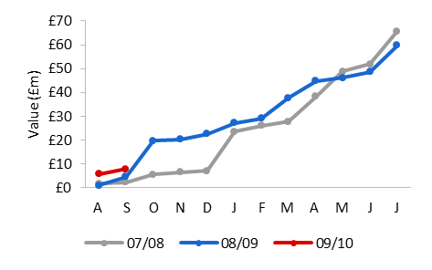
Audience: Senior Management
How are we doing compared to last year/forecast?
How are we doing against the competition?
© University of Warwick 2013

Slide 6
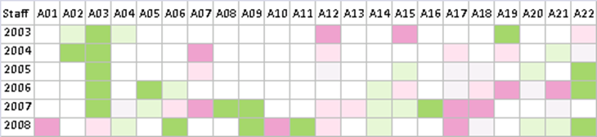
Audience: Heads of Department
How are individuals performing in my department?
How can improvements in performance be correctly targeted?
© University of Warwick 2013

Slide 7
Audience: Individual Academics
How does my performance compare with previous years?
How does my performance compare with that of my peers?
© University of Warwick 2013

Slide 8
Warwick’s Design Framework
What specific questions do you want to answer?
Which data are available to answer your question(s)
What are the limitations of the data?
Benchmark? Are comparable datasets available?
How should the data best be presented?
What activity do you want to better understand
Who’s the report for?
Is history & trajectory important?
Should I collect new data, what’s the benefit?
© University of Warwick 2013

Slide 9
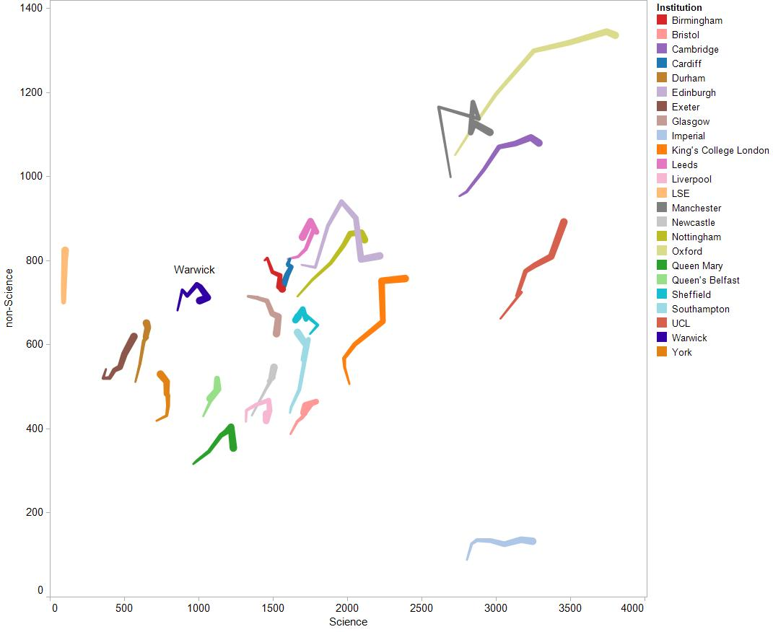
Tadpole Charts
Demonstrates trajectory of data over time
Smaller ‘tail’ end represents the ratio in the first year of analysis
Larger ‘head’ represents the ratio in the final year
Colour used to distinguish between items
e.g. Science vs. non-science academic staff base over time
© University of Warwick 2013

Slide 10
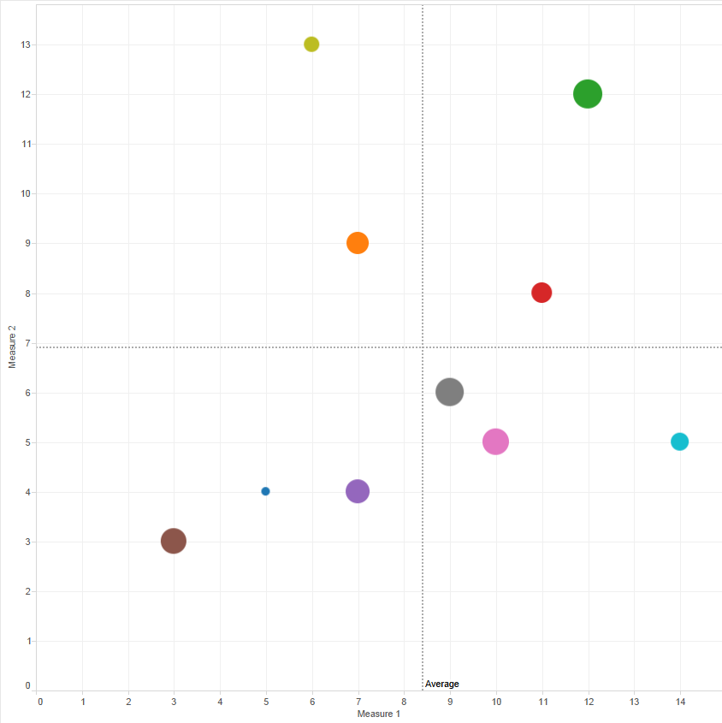
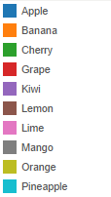

Bubble Charts
Shows ratio between two measures
Spot size can be used to show a third measure
Colour used to distinguish between groups or items
e.g. relationship between teaching and research measures of departments in the institution
© University of Warwick 2013

Slide 11
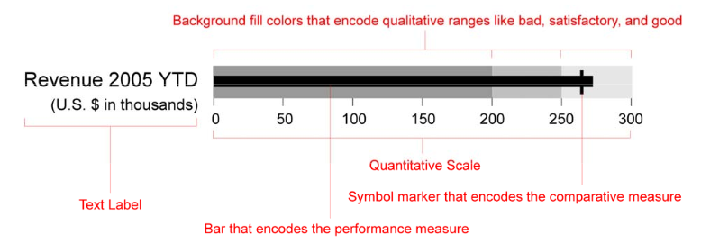
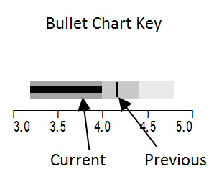
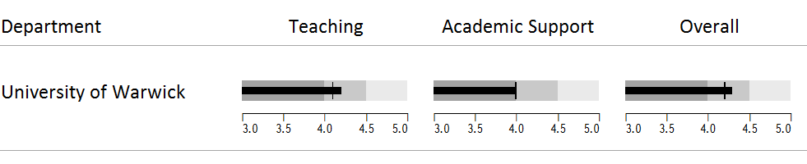
Bullet Charts
Developed to replace meters and gauges
Single quantitative measure
Other complementary measures to enrich meaning
Allows comparison with a target
e.g. Year-on-year comparison of NSS results
http://www.perceptualedge.com/articles/misc/Bullet_Graph_Design_Spec.pdf
© Stephen Few 2006-2010
National Student Survey results 2008/9
© University of Warwick 2013

Slide 12
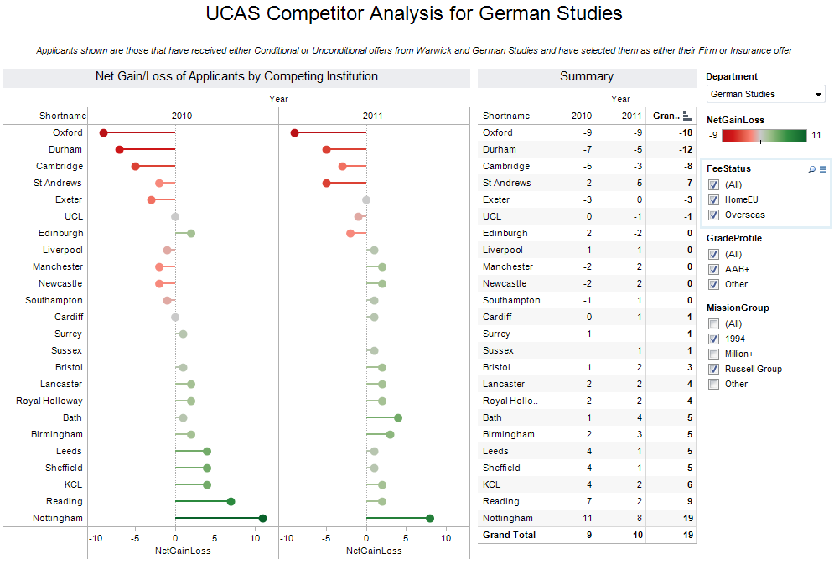
Lollipop Charts
Used to show net loss/gain
Red lollipop shows net loss to a competitor
Green lollipop shows net gain from a competitor
e.g. loss/gain of students holding offers from Warwick to/from other institutions
© University of Warwick 2013

Slide 13
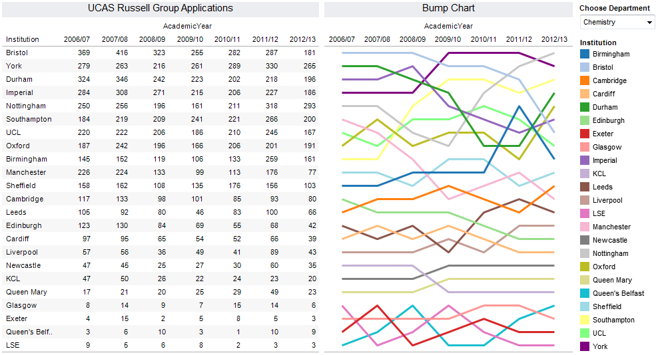
Bump Charts
Bump charts show change in a particular measure over time
e.g. How applications to study a course have changed at selected institutions over time

Slide 14
Solving Business Problems with Business Analytics
Good data visualisation removes the need for a comprehensive narrative
Important to prevent misunderstandings by explaining what the data doesn’t do
Used a range of data visualisations to solve business problems across different areas of the University
Technology
Combination of dashboards/reports and ad hoc data analysis

Slide 15

Timetable Rebuild
Rebuild of teaching timetable
Analysis of room usage (by bookings) across the academic year
Heatmap shows room bookings by hour/day/week/term
High % of room bookings represented in green
Low % of bookings in red
Can drill down by area on campus/building for more detailed analysis
© University of Warwick 2013

Slide 16
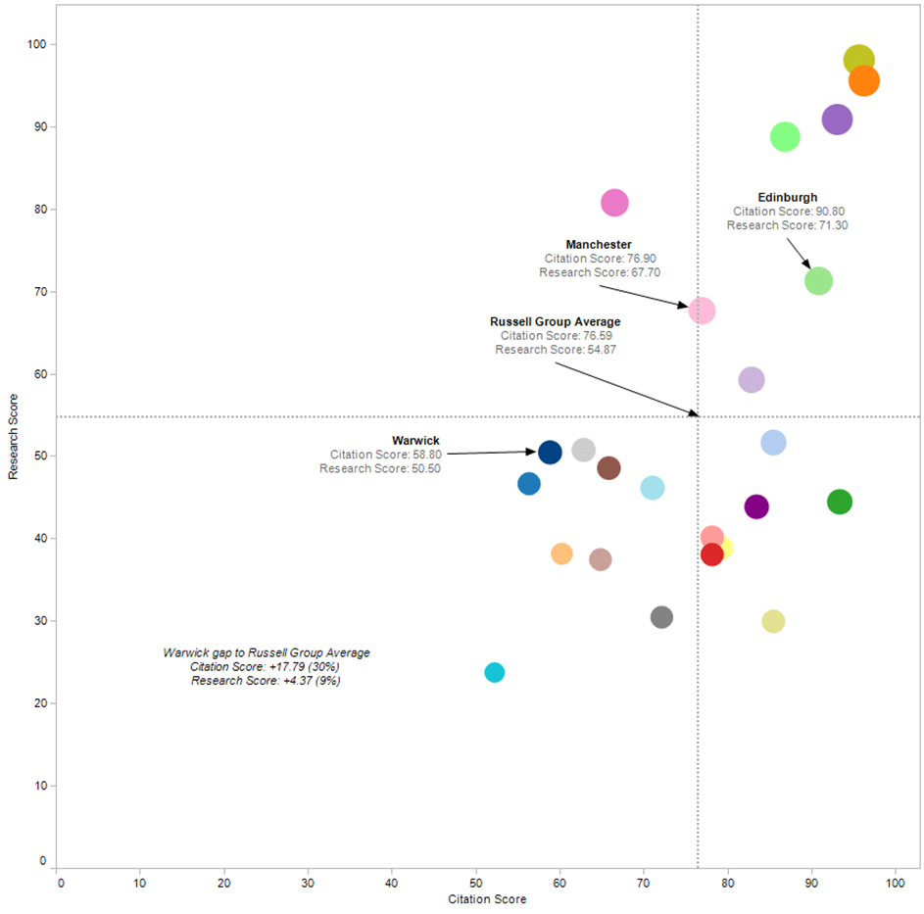
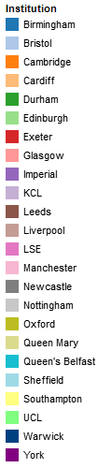
Corporate Strategy Refresh
Where do we want to be?
Analyse historical performance across different areas of strategic importance
Competitor analysis
Use data to inform future strategy & target setting
Source: THE 2013
© University of Warwick 2013

Slide 17

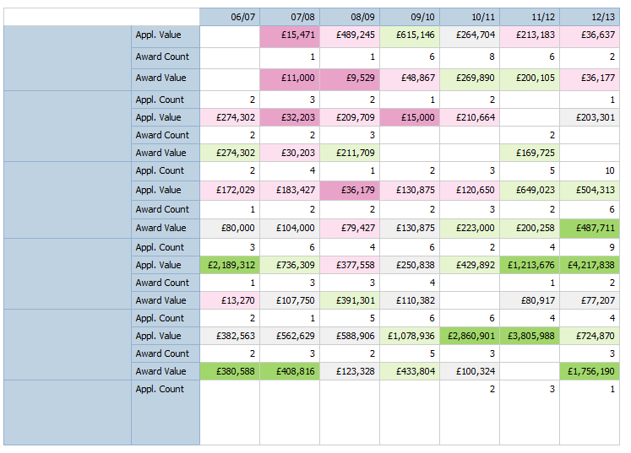
Research Assessment & Planning
Internal research assessment and planning
Planning and forecasting of research income
Heatmap shows quintile colour-coded profile for a department
Shows research grant applications and awards (count and value) for each academic
Benchmarked against departmental percentiles
Prof. Nick Wyatt
Dr. Sam Cole
Dr. Paul Johnstone
Prof. Emma Melia
Dr. Rebecca Lamberts
© University of Warwick 2013
Notes:
The heatmap shading is based on the following percentiles of application and award values of staff applying for awards within a department for a particular year. The statistics do not account for staff that have not applied for grants or contracts in a particular year....

Slide 18
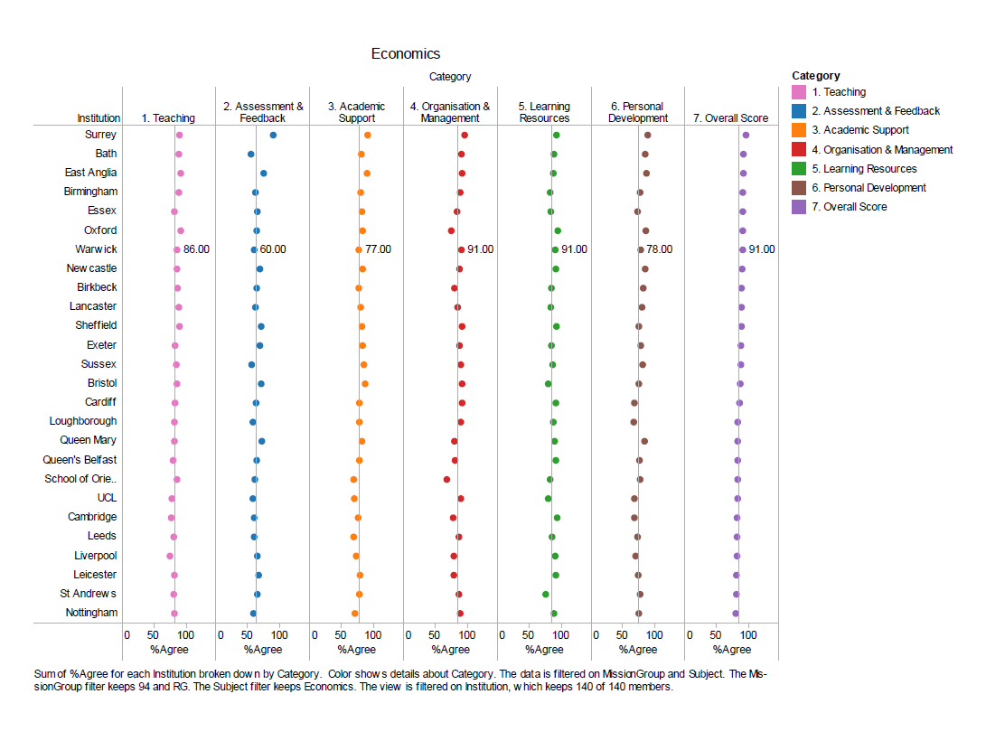
Student Satisfaction
National Student Survey results used to measure student satisfaction
Benchmark performance against other institutions
Reference lines represent mean score in that category for the subject
Quick visualisation of a large data set
© University of Warwick 2013

Slide 19
Summary
Good data visualisation removes the need for extensive narrative
  Know your audience
  Use colour to link information and highlight differences in data
  Contextualise and compare
  Use clean designs
Choose visualisations that address the specific questions to be answered
Make clear what the limitations of the data are
© University of Warwick 2013

Slide 20

Contacts
Giles Carden g.carden@warwick.ac.uk
www2.warwick.ac.uk/services/spa
http://uk.linkedin.com/in/gcarden
© University of Warwick 2013

